Slide 1
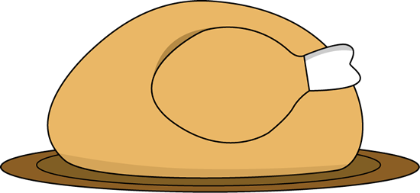
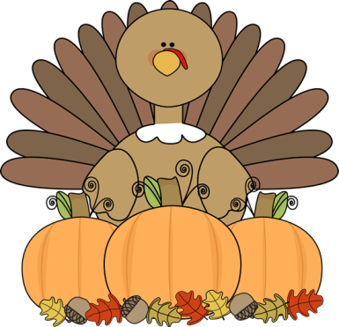
NOV. 14-17, 2016
Ms. Crouse and Mrs. Leverence
Second Grade
alcrouse@interact.ccsd.net aaleverence@interact.ccsd.net
Reminder: Thanksgiving is next week. There is no school the week of Thanksgiving. Enjoy your break!
The weeks following Thanksgiving and leading up to the holidays will be a busy time for us. If your family does not participate in winter holidays/activities, please let us know so we can make other arrangements for your child.
After the break next week, we will discuss family traditions. If you would like to share a food, craft, or activity with the class, we will be asking for volunteers in the coming weeks.
Scholastic Book Orders: If you would like to order books, please remember:
- Put your child's name on the form - Checks should be made payable to
Scholastic Reading Club - We can NOT accept cash - You can order online with a credit
or debit card (scholastic.com/
readingclub) - Our class code is LHKVV
What’s going on in school: Reading: Fluency/comprehension Math: Addition Writing: Opinions Social Studies: Thanksgiving
Read 20 minutes each evening.
Nov. 1: Christopher’s birthday Nov. 8: Election Day - No School Nov. 11: Veterans’ Day Nov. 23: Andy’s birthday Nov. 24: Thanksgiving Nov. 21-25: Thanksgiving Week - No School all week
IMPORTANT DATES

