Slide 1
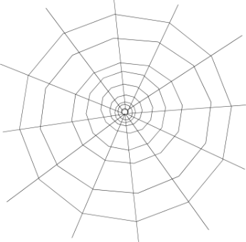
OCT. 17-20, 2016
Ms. Crouse and Mrs. Leverence
Second Grade
alcrouse@interact.ccsd.net aaleverence@interact.ccsd.net
Make-up pictures are scheduled for Oct. 24th.
In the coming weeks, you will be receiving information about the Nevada Read by Grade 3 initiative. If you have any questions, please contact Ms. Crouse.
Our class Halloween celebration will be Monday, October 31st, at the end of the day. More information will be sent home next week.
Don’t forget: We have P.E. every day. Please wear/bring appropriate shoes.
What’s going on in school: Reading: Main Idea /Details Math: Numbers in Base Ten (Place Value) Writing: Complete Sentences / Details Social Studies: maps/Nevada
Read 20 minutes each evening.
Math Websites to practice place value: http://gamequarium.com/placevalue.html http://interactivesites.weebly.com/place-value.html
Oct. 1: Bailey’s birthday Oct. 3: Esteban’s birthday Oct. 10: Columbus Day (we ARE in school this day) Oct. 12: Eileen’s birthday Oct. 24: Damian’s birthday Make-up Picture Day Oct. 31: Halloween (party!) Nevada Day o
IMPORTANT DATES

