Slide 1
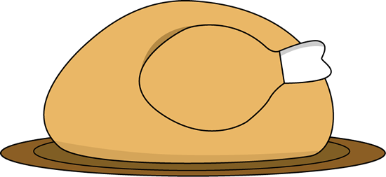
OCT. 31 – NOV. 3, 2016
Ms. Crouse and Mrs. Leverence
First Grade
alcrouse@interact.ccsd.net aaleverence@interact.ccsd.net
Thank you to all who contributed to our class Halloween party. The students had a great time – and so did the teachers! There were some great costumes, too. ☺
Our classes are in need of zippered baggies of all sizes, especially gallon and sandwich sizes. If you would be willing to donate, we would really appreciate it.
November has several days of non-attendance. Please mark your calendars.
We are currently in the process of constructing a webpage on www.sandyvalleyschool.com where we will post information about the first and second grade classes and digital copies of papers sent home. Keep an eye out!
What’s going on in school: Reading: CVC words and fluency/sight word mastery Math: Numbers 0-100 (place value/base ten) and addition Writing: beginning/ending sounds Social Studies: Election Day
Read 20 minutes each evening.
Math Websites to practice addition: http://www.abcya.com/base_ten_fun.htm http://mrnussbaum.com/63grade1/
Nov. 8: Election Day - No School Nov. 11: Veterans’ Day Nov. 24: Thanksgiving Nov. 21-25: Thanksgiving Week - No School all week
IMPORTANT DATES

